Slide 1
Including Assistive Technology (AT) in the Individual Family Service Plan (IFSP) and Individualized Education Program (IEP)
Training materials created by the Technology to Improve Kids’ Educational Success (TIKES) Project, a project of PACER Center: PACER.org/stc/tikes
Notes:
Slide 1: Intro Slide

Slide 2
Including Assistive Technology (AT) in the Individual Family Service Plan (IFSP) and Individualized Education Program (IEP) Training materials created by PACER Center for Technology to Improve Kids’ Educational Success (TIKES) Project
Paula Goldberg, PACER Center Executive Director
Bridget Gilormini, Director PACER’s Simon Technology Center
Notes:
Slide 2: Workshop Information
Presenter Notes:
Workshop presenters may wish to insert location, date, and name of presenters on this slide.

Slide 3
Federally Funded Early Childhood and Assistive Technology Grants
Education priority based on research that shows assistive technology is underutilized by children with disabilities ages birth to 5
One of three grants awarded in the country by U.S. Department of Education’s Office of Special Education Programs (OSEP)
You play an important role in equipping not only yourselves but future early intervention and early childhood providers and teachers across the U.S.
Notes:
Slide 3: About TIKES
Presenter Notes:
TIKES (Technology to Improve Kids’ Educational Success) is one of three early childhood and assistive technology model demonstration grants awarded nationally. This education grant is based on a priority to improve outcomes for children with disabilities ages birth to 5 by leveraging the use of assistive technology to bridge developmental and achievement gaps. Research shows that assistive technology is underutilized and under documented for children with disabilities ages birth to 5. The majority of families do not learn about assistive technology from their teachers or providers but from other families. This grant is about developing a model of training materials to equip and support educators and families by increasing their knowledge and awareness of assistive technology and helping them identify appropriate technology solutions for their children or students.

Slide 4
PACER Center
An established national center providing important information to parents and educators for more than 36 years
More than 30 different programs
PACER.org
952-838-9000
Notes:
Slide 4: About PACER Center
Presenter Notes:
PACER Center is a national parent center built on the premise of parents helping parents. For more than 36 years, PACER Center has been helping families work collaboratively with educators. PACER Center also works closely with schools and school districts, educators, and providers to help them understand the parent perspective, provide valuable staff training resources, and offer resources from over 30 different programs that include transition, bullying, early childhood, state personnel development grants, and many more.

Slide 5
Simon Technology Center
Celebrating over 28 years of assistive technology services and projects
Dedicated to making the benefits of technology more accessible
PACER.org/STC
952-838-9000
Notes:
Slide 5: About the Simon Technology Center
Presenter Notes:
For over 28 years, the knowledgeable staff of the Simon Technology Center (STC) have been making the benefits of assistive technology accessible to families, educators, and consumers. The STC does this through a variety of core services and assistive technology projects that include free assistive technology explorations with families and their children, information and referral services, workshops, and a vast lending library to support the exploration of assistive technology.

Slide 6
Session Agenda
Defining Assistive Technology (AT)
The Conversation of Including AT
How to Consider AT
Choosing the Right AT
Documenting AT Decisions
Closing Thoughts, Questions, & Evaluations
Notes:
Slide 6: Session Agenda
Presenter Notes:
“Including Assistive Technology in the IFSP/IEP” is a workshop designed to help educators and families learn about the legal requirement to consider assistive technology for children ages birth to 5 with a disability. Consideration is a legal requirement as part of the Individuals with Disabilities Education Act (IDEA).
This presentation will define assistive technology and provide an overview of the IDEA requirement to consider AT, talk about the conversation of including AT in the IFSP and IEP, share information about how to consider AT, discuss choosing and documenting AT, and finally share some closing thoughts about this very important process.

Slide 7
Defining Assistive Technology (AT)
Page 7
Notes:
Slide 7: Defining Assistive Technology (AT)
(Transition slide leading into the definition of assistive technology devices and services and why it is important to consider using AT with young children.)

Slide 8
Why Include AT?
Considering AT is a legal requirement for every child with an Individual Family Service Plan (IFSP) or Individualized Education Program (IEP).
It is best practice and good for kids!
Notes:
Slide 8: Why Include AT?
Presenter Notes:
Including AT is a legal requirement for every child with an Individual Family Service Plan (IFSP) or Individualized Education Program (IEP). The language used in the law says we must “consider” assistive technology. It is also best practice and good for kids. Assistive technology opens doors of opportunities.

Slide 9
Using AT to Increase Participation
Participation in everyday routines and activities creates a foundation for development.
Participation occurs when a child successfully engages in an activity with only the amount of adult support as is needed by most children.
Notes:
Slide 9: Using AT to Increase Participation
Presenter Notes:
Assistive technology helps children with disabilities (ages birth to 5) participate in everyday routines and activities, in the classroom and at home, in order to grow and learn. The purpose of assistive technology is to create opportunities for children. All children need interactions that will allow them to grow and change. Assistive technology needs to be built into the daily routines and activities of the child. For young children, participation in everyday routines and activities creates a foundation for their development. Participation occurs when a child successfully engages in an activity with only the amount of adult support as is needed by most children.

Slide 10
Using AT to Increase Opportunities
Assistive technology serves as a bridge between a child’s current skills and what a child is expected to do or desires to do.
Once the bridge is “built” opportunities for participation in everyday routines and activities expand.
Notes:
Slide 10: Using AT to Increase Opportunities
Presenter Notes:
Assistive technology can be a bridge between what a child can do independently and what a child is expected to do or wants to do. This bridge gives children with disabilities opportunities that were not there before the introduction of assistive technology. Once the bridge is built, opportunities for participation in everyday routines and activities expand.

Slide 11
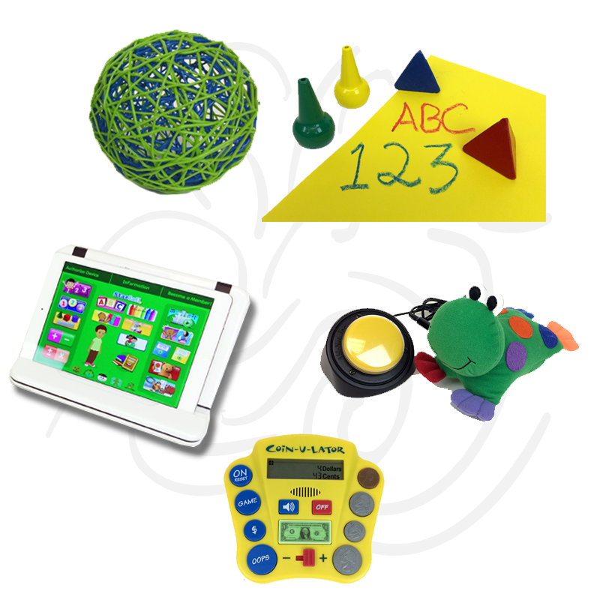
AT Devices: Defined
Assistive technology (AT) devices are any item, piece of equipment, or product system used to increase, maintain or improve the functional capabilities of a child with a disability.
Notes:
Slide 11: AT Devices: Defined
Presenter Notes:
To make sure we’re all on the same page, let’s revisit the federal definition of assistive technology. Assistive technology is defined as both devices and services. Devices are defined as any item, piece of equipment, or product system that is used to increase, maintain, or improve the functional capabilities of a child with a disability.
Reference:
Assistive technology DEVICES are identified in the IDEA 2004 as:
Any item, piece of equipment, or product system, whether acquired commercially off the shelf, modified, or customized, that is used to increase, maintain, or improve the functional capabilities of children with disabilities.
The term does not include a medical device that is surgically implanted, or the replacement of such device.
(Authority 20 U.S.C. 1401(1))
Section 300.105 in the Federal Register based on the most recent re-authorization of IDEA:
Each public agency must ensure that assistive technology devices or assistive technology services, or both, as those terms are defined in Sections 300.5 and 300.6, respectively are made available to a child with a disability if required as a part of the child’s —
Special education under Section 300.36;
Related services under Section 300.34; or
Supplementary aids and services under Section 300.38 and 300.114(a)(2)(ii).
On a case-by-case basis, the use of school-purchased assistive technology devices in a child’s home or in other settings is required if the child’s IEP team determines that the child needs access to those devices in order to receive a Free Appropriate Public Education or FAPE.

Slide 12
In Simple Language
Assistive Technology Device is
Any Thing
That Helps
A Child with a Disability/Delay
Do Something
They Could Not Do Without It
Gilormini, Milbourne, Mistrett, 2014
Notes:
Slide 12: In Simple Language
Presenter Notes:
Simply said, assistive technology devices are anything that helps a child with a disability or developmental delay do something they could not do without it. It is a bridge that lets children participate in and fully experience life.

Slide 13
OSEP Part C Clarification Letter
“AT devices are required only if they relate to the developmental needs of the infants and toddlers served by the program.”
Notes:
Slide 13: OSEP Part C Clarification Letter
Presenter Notes:
In 2003 the Office of Special Education Programs (OSEP) released a Part C Clarification Letter about the use of AT specifically with infants and toddlers. It states “AT devices are required only if they relate to the developmental needs of the infants and toddlers served by the program.” Further, “linking the provision of those devices to an education benefit is not appropriate under a program that serves children from birth to age 3.” This means that assistive technology should be linked to appropriate routines and activities as part of the child’s IFSP.
There are further clarifications in this letter including selecting AT with family collaboration. The letter in full can be found at www2.ed.gov.
All children develop within the context of everyday activities, which are the primary sources of learning opportunities for a child. There are five developmental domains to consider: physical, social-emotional, language, cognitive, and adaptive. These developmental areas are interrelated and unique for every child. Participation is critical to a child’s development and in the context of routines provides both planned and unplanned learning opportunities. It allows for a child to practice functional skills. Everyday routines have many contexts and occur in the home or community, at mealtime or during outside play, and at events such as birthday parties.
Reference:
[Link to OSEP Part C Clarification Letter: http://www2.ed.gov/policy/speced/guid/idea/letters/2003-1/goodman032503earlyinter1q2003.pdf]

Slide 14
Keep in Mind That…
AT for infants and toddlers looks different than AT for students & adults.
AT for infants and toddlers is used to support a child’s development.
Many changes occur as children grow, requiring dynamic and flexible use of AT.
Notes:
Slide 14: Keep in Mind That…
Presenter Notes:
AT for infants and toddlers looks different than AT for students and adults. AT for infants and toddlers is used to support a child’s development. Many changes occur as young children grow which requires dynamic and flexible use of AT.

Slide 15
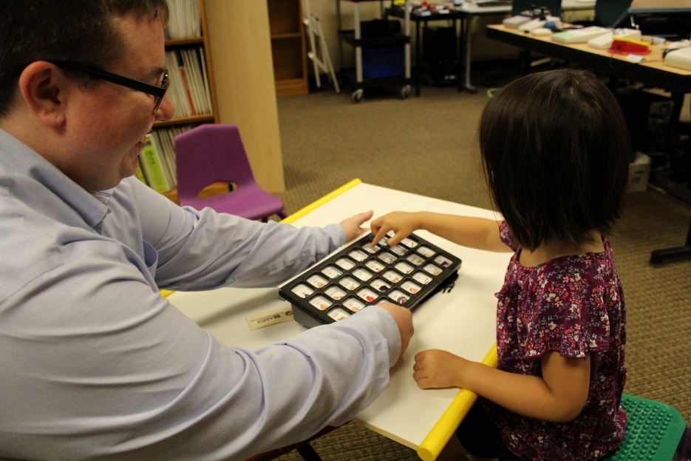
AT Services: Defined
Assistive technology services help with the selection, development, maintenance, repair, and training in the use of assistive technology.
Notes:
Slide 15: AT Services: Defined
Presenter Notes:
Assistive technology services are those services that assist with the selection, development, maintenance, repair, and training in the use of the device. We often spend a lot of time on choosing the technology and neglect to ensure that the service part of assistive technology is talked about and documented. It is important to know what will happen if a device needs repair or replacement and who will take responsibility for this to ensure that technology is available to the child that needs it.
Reference:
As defined in IDEA, an assistive technology SERVICE is:
Any service that directly assists a child with a disability in the selection, acquisition, and use of an assistive technology device. The term includes -
Evaluating the needs of a child with a disability, including a functional evaluation of the child in the child’s customary environment;
Purchasing, leasing, or otherwise providing for the acquisition of assistive technology devices by children with disabilities;
Selecting, designing, fitting, customizing, adapting, applying, maintaining, repairing, or replacing assistive technology devices;
Coordinating and using other therapies, interventions, or services with assistive technology devices, such as those associated with existing education and rehabilitation plans and programs;
Training or technical assistance for a child with a disability or, if appropriate, that child’s family; and
Training or technical assistance for professionals (including individuals providing education or rehabilitation services), employers, or other individuals who provide services to, employ, or are otherwise substantially involved in the major life functions of that child.
(Authority 20 U.S.C. 1401(2))

Slide 16
In Simple Language
Assistive Technology SERVICE is
Any Behavior
That directly Assists
a family of a child with a Disability/Delay
consider, trial, SELECT, ACQUIRE, and USE
assistive technology devices
Gilormini, Milbourne, Mistrett, 2014
Notes:
Slide 16: In Simple Language
Presenter Notes:
Simply said, assistive technology service is any behavior that directly assists a family of a child with a disability or developmental delay consider, trial, select, acquire, and use assistive technology devices.

Slide 17
Everyone’s Responsibility
Everyone on the team has something important to contribute to the conversation about assistive technology
AT is everyone’s responsibility
Notes:
Slide 17: In Simple Language
Presenter Notes:
AT is everyone’s responsibility. A great benefit of special education services is working with a multi-disciplinary team. An IFSP or IEP team always includes the family and may also include a special education teacher, a speech language pathologist, an occupational therapist, a physical therapist, an assistive technology specialist, an autism specialist, a vision or hearing specialist, and others. Every team is specifically designed to meet a child’s individual needs. Because each team is specifically built to meet the needs of the child, you have all the right people to have a meaningful conversation about assistive technology. A teacher will likely have the most knowledge about AT for academics, classroom or home routines, while a speech therapist may know about AT for communication, and an occupational therapist can talk about AT for sensory regulation. Parents know the most about their child!

Slide 18
The Conversation of Including Assistive Technology
Page18
Notes:
Slide 18: The Conversation of Including Assistive Technology
(Transition slide leading into the conversation about the legal requirements of consideration and how to “consider” assistive technology.)

Slide 19
Individuals with Disabilities Education Act (IDEA)
IDEA requires that assistive technology be CONSIDERED for all students with a disability who have an IFSP or IEP.
Notes:
Slide 19: Individuals with Disabilities Education Act (IDEA)
Presenter Notes:
The Individuals with Disabilities Education Act (IDEA) is the federal special education law that addresses services for children with disabilities. It was signed into law in 1975. IDEA requires that states provide a free appropriate public education (FAPE), including related services for children with disabilities. This law requires schools to provide necessary assistive technology devices and services to help children with disabilities receive an appropriate education. For every child with an IFSP or IEP, assistive technology must be considered.
The IFSP or IEP team has some flexibility in how they consider assistive technology. The important issue is to have a conversation about including AT and to document that you have looked at the needs of the child and explored AT options. Documenting your process gives clear evidence that you have indeed considered assistive technology and clearly communicates with all team members what AT is being tried or used with a child.

Slide 20
The Conversation of Including AT
Generally, consideration is a relatively short process, or discussion, in which IFSP/IEP team members use information analysis and critical decision-making to determine student needs for AT.
Notes:
Slide 20: The Conversation of Including AT
Presenter Notes:
Generally, consideration is a short process, or discussion in which IFSP/IEP team members use information analysis and critical decision-making. The discussion should define the needs and identify possible assistive technology that has the required features to meet the needs of the child. For more complex needs, the conversation may be longer and more in depth.
The Individual Family Service Plan (IFSP) or Individualized Education Program (IEP) will be your roadmap through the birth-to-5 system. It will show you where you are starting from and where you plan to go. The team (including the family, service coordinator/provider) should check it to make sure that everything is still on course. Everyone has valuable information and insight to share with each other about a child's strengths, needs, likes, and dislikes. That, along with information from the education evaluation and medical information from a child's doctor, will define the starting point for considering AT.

Slide 21
True or False
Consideration of AT is the same as an assessment or evaluation.
Notes:
Slide 21: True or False
Presenter Notes:
False. Consideration is not an assessment or evaluation. Consideration is a process that includes discussion about a child’s progress or lack of progress and needs, establishes parameters around trying assistive technology or discusses the effectiveness of AT already being used. AT assessments and evaluations are done by qualified professionals when a team is not sure about where to start with AT. It is important to note that you do not need to have an evaluation done in order to include AT in the IFSP/IEP.
When is an assessment for assistive technology appropriate? It is appropriate when the parent requests an evaluation in writing, if the team cannot identify devices or strategies to help the student meet educational goals, and if equipment trials are inconclusive.
When making a request for an evaluation, the parent should put in writing and present to the school. A formal assistive technology assessment is useful when the IFSP/IEP team has not identified appropriate and useful assistive technology tools that may help the child or student meet their goals. It is the school’s responsibility to provide and pay, if necessary, for this assistive technology evaluation.

Slide 22
In Simple Language
Consideration is a process that includes discussion among a child’s team about progress and how AT might help meet a child’s needs.
Notes:
Slide 22: In Simple Language
Presenter Notes:
Simply said, consideration is a process that includes discussion among a child’s team about progress and how AT might help meet a child’s needs.

Slide 23
AT is One of the Five Special Factors for Consideration
1. Assistive technology
2. Child’s behavior
3. Language needs (e.g., student is an English language learner)
4. Need for alternative language (e.g., braille, American Sign Language)
5. Communication needs
Notes:
Slide 23: AT is One of the Five Special Factors for Consideration
Presenter Notes:
One of the five special factors for consideration is assistive technology. As mentioned earlier, consideration is meant to be a discussion that generally occurs at the initial and annual IFSP/IEP meetings. The conversation about AT should be captured and documented on the IFSP/IEP and can be listed in many areas. This conversation can also happen when there are changes in need, environment, technology, or whenever the situation warrants a discussion to address the changes. Sometimes one of the other five factors impacts the conversation about AT. For example a child who cannot speak, demonstrating a communication need, would benefit from augmentative alternative communication or AAC, a category of assistive technology.

Slide 24
Parent Role in the Process
The concerns of the child’s family should be part of the IFSP/IEP process and can include a family’s desire to
Use or try AT.
Notes:
Slide 24: Parent Role in the Process
Presenter Notes:
The IFSP, the document used for children under age 3, focuses on family, home, and community activities and routines. The IEP, the document used for children age 3 and over, often focuses on education and academic skills. Parent concerns and desires for their child should always be taken into consideration, including a family’s interest in AT. Ultimately decisions will be made with the whole team which includes the parents. If parents disagree with the choices of the team or do not understand the IFSP or IEP, they have the right to ask for clarification or an additional meeting before signing the document.

Slide 25
IFSP Team is Required to Discuss…
A child’s present skill level in all 5 developmental domains.
Voluntary family directed assessment to identify concerns, priorities, and resources plus services and supports necessary to enhance family's capacity to meet the child’s needs.
Functional outcomes based on family priorities with services to achieve outcomes.
Steps for transition to Part B Services.
Notes:
Slide 25: IFSP Team is Required to Discuss…
Presenter Notes:
When the IFSP team meets, they are required to consider assistive technology. It should be discussed in the context of the 5 developmental domains and the family’s concerns and priorities. A voluntary family directed assessment or a family interview can be used to identify concerns, priorities, and resources along with services and supports that are necessary to enhance a family’s capacity to meet their child’s needs. The IFSP team is also required to discuss functional outcomes based on the family’s priorities with services to achieve desired outcomes. Finally, the team should discuss the steps for transition to Part B Services. Assistive technology can and should always be considered within this context.

Slide 26
IEP Team is Required to Discuss…
Student’s strengths
Educational concerns of parents
Most recent evaluation results
Five special factors for consideration
Notes:
Slide 26: IEP Team is Required to Discuss…
Presenter Notes:
When the IEP team meets they are required to consider four areas for each student. These areas include the student’s strengths, the educational concerns of the parents, the most recent evaluation results, and the five special factors for consideration, which include whether assistive technology could help the child achieve his or her IEP goals. In addition, teams will discuss progress on IEP goals.
The reauthorization of the Individuals with Disabilities Education Act (IDEA) in 1997 clarifies the school’s obligation to provide assistive technology. To the extent required by this federal law as of July 1, 2000, every school district must ensure that all students with disabilities are provided the special instruction and services appropriate to their needs, including the consideration of assistive technology.

Slide 27
How to Consider AT
Page27
Notes:
Slide 27: How to Consider AT
(Transition slide leading into a discussion of the Child-Centered AT Plan to guide both IFSP and IEP teams through the process of consideration.)

Slide 28
A Child-Centered AT Plan
To help IFSP and IEP teams consider assistive technology for children ages birth to 5 and document it appropriately, PACER’s TIKES Project has developed a Child-Centered AT Plan.
Notes:
Slide 28: A Child-Centered AT Plan
Presenter Notes:
To assist IFSP and IEP teams with the process of considering AT and to help them document appropriately, the TIKES Project has created a Child-Centered AT Plan. The document is simple and easy to use and will help providers improve their documentation of assistive technology.

Slide 29
Easy to Use
A simple helpful tool to help teams:
Intentionally go through the possible outcomes of including AT in the IFSP/IEP
In the planning and implementation of AT
Notes:
Slide 29: Easy to Use
Presenter Notes:
The Child-Centered AT Plan was developed to help teams meet their requirement to consider assistive technology for infants, toddlers, and preschoolers. This simple and easy-to-use tool goes through the possible outcomes of considering AT and gives recommendations about where and how to document. This plan is covered in detail in the training material “A Child-Centered AT Plan.”
There are two versions of the Child-Centered AT Plan, one for the IFSP and one for the IEP. The language used in each version reflects the differences in age and environment and the value placed on routines and activities in the IFSP. We’ll go more in depth with details on how to use the Child-Centered AT plan in another set of training materials.

Slide 30
Possible Outcomes of Consideration
AT was considered and is not needed at this time.
The student is successfully using AT.
The team has determined that the child, who is not currently using AT, needs AT and has enough information to make decisions about specific AT.
The child needs AT, but the team needs information to determine the type of AT that would meet the needs of the child.
Notes:
Slide 30: Possible Outcomes of Consideration
Presenter Notes:
Here are four possible outcomes when considering assistive technology for young children. First, let’s talk about the outcomes and then we’ll talk about appropriately documenting these outcomes.
The first possible outcome is “AT was considered and is not needed at this time.” The team discusses the needs of the child and determines that the child is making progress with the current adaptations and modifications in place. The team will document this outcome and relevant parts of the conversation. We’ve put some emphasis on “at this time.” At times, there are rapid changes in development and needs and the team will need to revisit if the child would benefit from assistive technology when this happens and progress is not being made.
The second possible outcome is “AT was considered and is successfully being used.” The team discusses the needs of the child and identifies assistive technology that the child is successfully using to participate in routines and activities to meet goals and objectives. The team will document this outcome and what AT the child is using.
The third outcome is “AT was considered and the student may benefit from AT to help them make progress.” The team discusses the needs of the child, identifies that the child is not making progress, and decides the child may benefit from assistive technology. The team will document this outcome, identify possible AT items to try, and determine what success looks like for the child. They will also determine a time frame in which the child will try the AT. It is essential that trying AT happens in a timely manner so the student gets the supports they need. When they have enough information to make a decision about what AT to include, the team will write this into the child’s IFSP or IEP.
With the fourth possible outcome, the team discusses the needs of the child and identifies that AT may help the child, but they need more information to determine what assistive technology the child would benefit from. They will likely need the assistance of someone who has knowledge and expertise in both assistive technology and early childhood development to guide them in their decision-making process. Together, they will identify possible AT items to try and determine what success looks like for the child. Here, a timeframe is also important. The team will set a timeframe in which the child will try the AT and make sure that trying AT happens in a timely manner so the student gets the supports they need. When the team has enough information to make a decision about what AT to include, they will write this into the child’s IFSP or IEP. As with all other outcomes, the team will document their decisions.

Slide 31
Choosing the Right AT
Page31
Notes:
Slide 31: Choosing the Right AT
(Transition slide leading into the conversation of trying and selecting appropriate assistive technology based on the child and the needs of the child.)

Slide 32
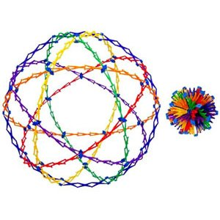
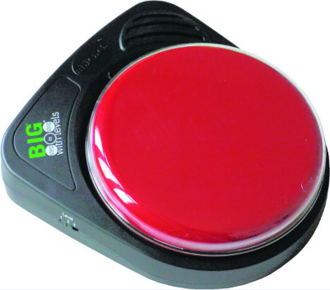
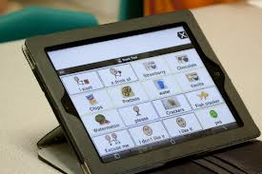
What AT is the Best AT?
?
?
?
Notes:
Slide 32: What AT is the Best AT?
Presenter Notes:
We know that considering assistive technology for children with a disability is a requirement in IDEA. We’ve briefly talked about the discussion of including AT and the four possible outcomes. Now let’s talk about making decisions about AT selection. There are many factors that affect the technology we might select including: knowledge of assistive technology, availability of AT to try and use, a rapidly changing market of assistive technology, and many items to sift through and understand. This part of the presentation is about meeting the requirements to consider AT and how to thoughtfully make decisions about matching technology with a child’s need(s).

Slide 33
What AT is the Best?
This is a challenging question as there are many variables.
Consider what the needs of the child are and what technology might meet those needs.
Notes:
Slide 33: What AT is the Best?
Presenter Notes:
So, what AT is the best AT? There are a variety of things to think about such as age, abilities, likes, interests, and motivators. Start with thinking about the needs of the child and what technology can meet those needs. Sometimes decisions about assistive technology are based only on what technology the person is familiar with or what they have used before. However, the child is the most important element in determining what tool is the best based on the needs of the child.

Slide 34
Trying AT
An AT “trial” gives a child a chance to try different types of AT.
Data is collected to show which piece(s) of AT best meet the child’s needs.
Trials typically lasts 2-6 weeks.
Notes:
Slide 34: Trying AT
Presenter Notes:
A trial is the process of testing something to assess its suitability or performance. “Trial” is a common term used among assistive technology professionals. In simple language, a trial is the process of trying something and measuring the impact of change when that AT is used.
An AT trial gives the child a chance to try different types of AT. During the process, data or information is collected to show or prove which piece or pieces of technology best meet the needs of the child. The length of time for a trial varies, but typically lasts 2-6 weeks. It is important to document what you are trying and how long you think the trial will take, gather information about how the child uses the AT, and then make a decision in a timely manner. This decision is then written into the IFSP or IEP.

Slide 35
Child-Centered, Skill-Based AT Decisions
The choices you make will be based on each individual child’s skills and needs.
Notes:
Slide 35: Child-Centered, Skill-Based AT Decisions
Presenter Notes:
The child’s needs are always more important than the assistive technology device. As we consider assistive technology, we first think about the child. We think about the child’s environment, the child’s routines and activities, the child’s interests and strengths, and the child’s needs. When appropriately considered, assistive technology has the potential to make a great difference even when implemented over a short period of time.

Slide 36
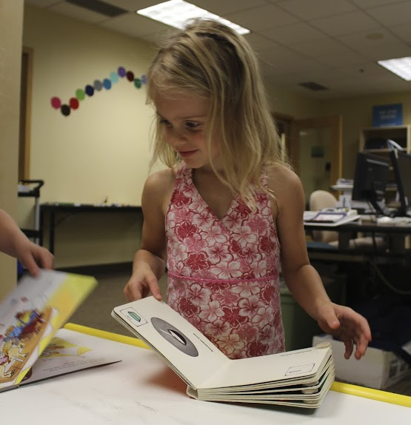
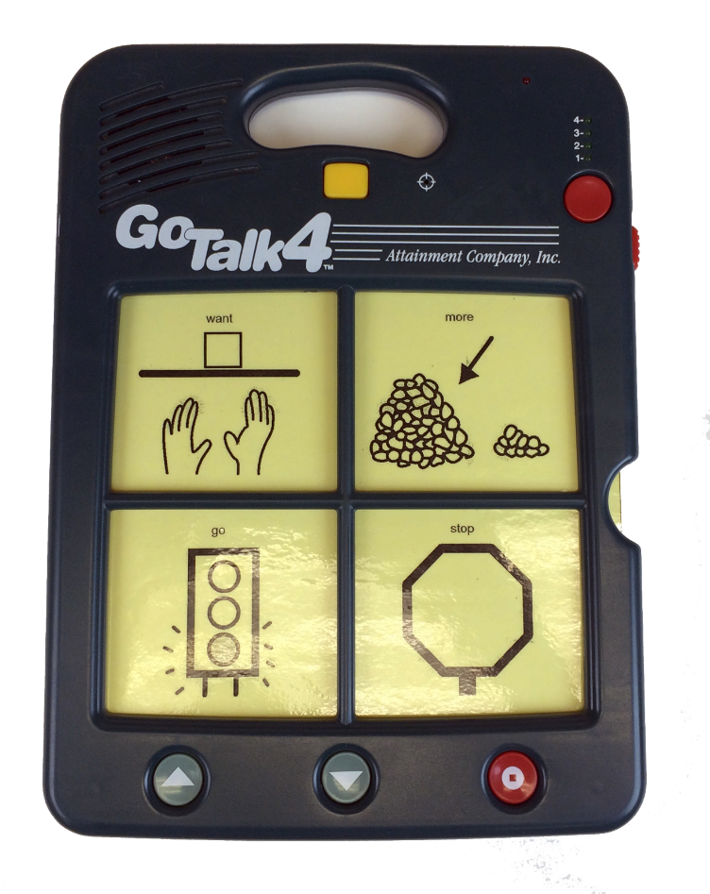
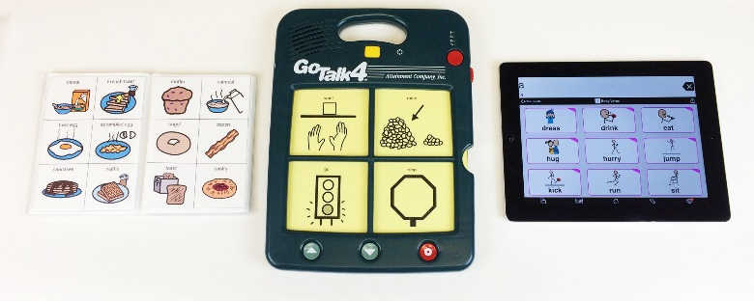
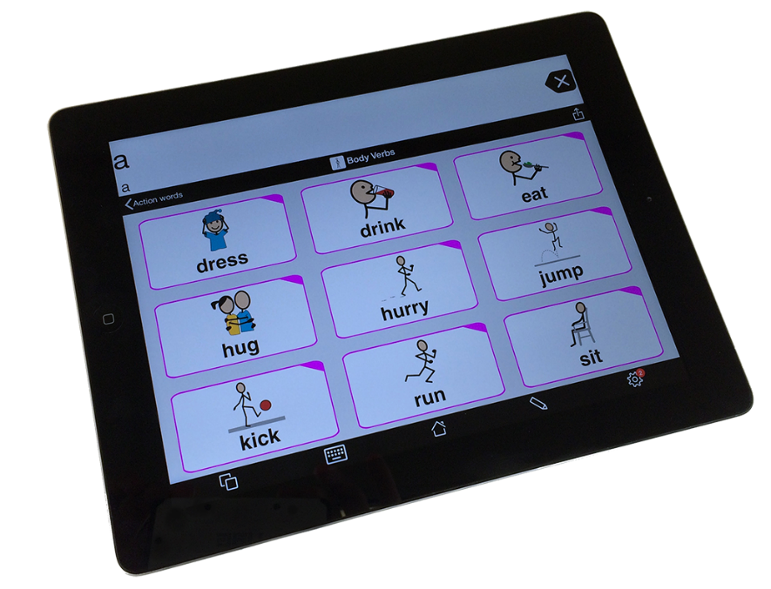
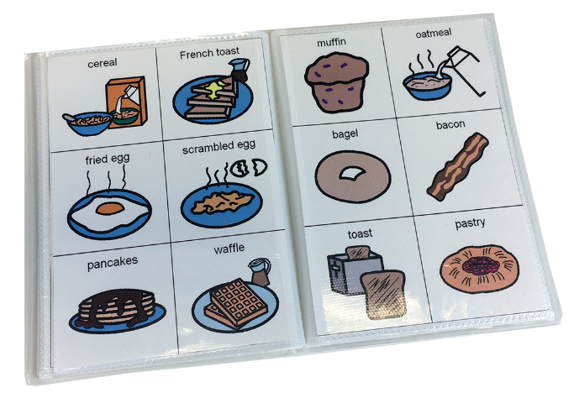
Case Study: Choosing the Right AT
Goal: Help Eva communicate with her peers
Plan: Try different types of communication devices for 3 weeks each
What AT is right for Eva?
Notes:
Slide 36: Case Study: Choosing the Right AT
Presenter Notes:
(1) Eva is a 4 year old girl who loves reading books and being outside. She is not yet using spoken language, but shows strong receptive language skills. How does her team choose the right AT?
During the conversation about AT for Eva, her team determined that she is ready for something with more than one or two messages, but there are many options! They decide to try (2) a picture communication book, (3) a static display communication device with overlays that can be inserted for different vocabulary, and (4) a high-end, dynamic display communication device. Eva will try each device for three weeks.
(5) Eva’s case manager sets up a data collection sheet so everyone who works with Eva can document her use of the device. Her team also comes up with a plan for who will set up and maintain each communication device and what to do if something breaks.
After nine weeks of trials, the team decides that (3) the static display device doesn’t give Eva enough word choices and that (4) the high-end device is visually over-stimulating for Eva. (2) The picture communication book is the right option for Eva. She becomes excited every morning to find her book and begin talking! (1) As Eva’s language skills grow, her team will continue to review the best AT option to meet her needs.
The above descriptions describe the pictures layered and embedded within the PowerPoint that will be shown during the electronic presentation of this slide.
The image transitions are documented in the script using the following key:
1 – bring up image of Eva
2 – bring up image of picture communication book
3 – bring up image of static display communication device with overlays
4 – bring up image of high-end up communication device
5 – bring up image of all three devices
Note: The layered images on this slide are designed to support the key messages of this sample case study. In the PowerPoint presentation, the image of Eva is the first image used. The key listed above will help you transition through images that support the script. For example, when you get to the first transition, marked with (2), press the space bar or your clicker to transition to the next picture. You will end on the image of Eva, because the child is the most important part of the process. Feel free to use your own images or the images we have provided for you.

Slide 37
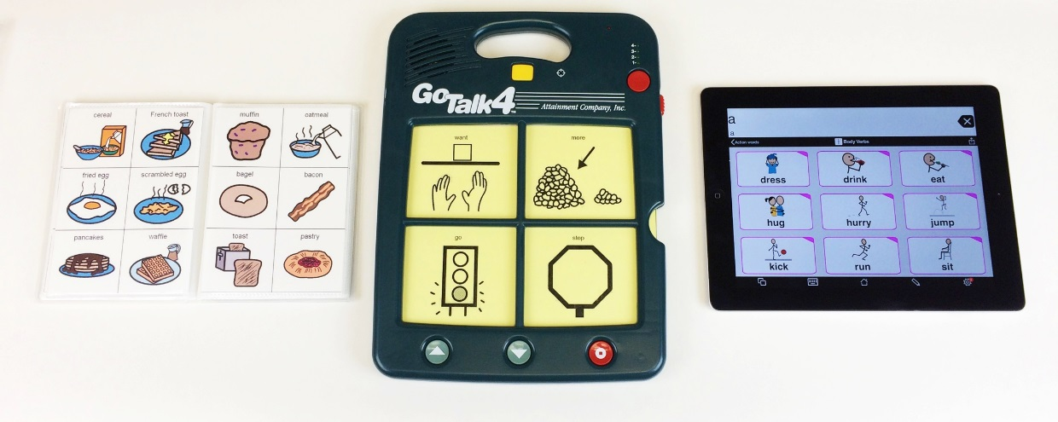
Case Study: Choosing the Right AT
Notes:
Slide 37: Case Study: Choosing the Right AT
The pictures on this slide represent the devices that Eva’s team decided to trial: a picture communication book, a static display device with interchangeable overlays, and a high-end dynamic display communication device.

Slide 38
Documenting AT Outcomes in the IFSP/IEP
Page 38
Notes:
Slide 38: Documenting AT Outcomes in the IFSP/IEP
(Transition slide leading into the conversation about how and where to document assistive technology in the IFSP/IEP.)

Slide 39
Documenting AT Outcome #1 in the IFSP/IEP
Outcome 1: AT was considered and is not needed.
Where to document in the IFSP | How to document in the IFSP/IEP
“What is already happening” | “The team has discussed the child’s needs and determined that he or she does not need assistive technology because (fill in how current supports or adaptations are meeting the needs of the child.)”
Where to document in the IEP
Assistive Technology section or Accommodations/Modifications
Notes:
Slide 39: Documenting AT Outcome #1 in the IFSP/IEP
Presenter Notes:
Assistive Technology Outcome #1: AT was considered and is not needed. The team met and had a conversation about the needs of the child and determined that current supports or adaptations are working and meeting the needs of the child. The child is meeting his or her goals and making progress. Based on the team’s discussion, they’ve determined that AT is not currently needed. The next step is to document this outcome. In the IFSP the outcome could be documented in “What is already happening.” In the IEP it is commonly documented in the Accommodations/Modifications section.

Slide 40
Documenting AT Outcome #2 in the IFSP/IEP
Outcome 2: The child is successfully using AT.
Where to document in the IFSP | How to document in the IFSP/IEP
“What is already happening” | “The child is currently using AT. He or she will use assistive technology to help him or her reach the following goals/outcomes. (Describe the features of the assistive technology and how it will help.)”
Where to document in the IEP
Assistive Technology section or Accommodations/Modifications
Notes:
Slide 40: Documenting AT Outcome #2 in the IFSP/IEP
Presenter Notes:
Assistive Technology Outcome #2: The child is successfully using AT. The team met and had a conversation about the needs of the child and determined that the child is currently successfully using AT. The conversation likely included what AT the child was using, in what environments he or she was using it, and what goals the AT was helping the child meet. The next step is to document this outcome. In the IFSP the outcome could be documented in “What is already happening.” In the IEP it is commonly documented in the Accommodations/Modifications section. It is common to write the features of the technology rather than brand names. This focuses on the features that work for the child and gives flexibility regarding brand choices and availability of technology that matches the needed features. Brand names can be written in if it is the only one of its kind that can meet the need.

Slide 41
Documenting AT Outcome #3 in the IFSP/IEP
Outcome 3: The team has determined that the child, who is not currently using AT, needs AT and has enough information to make decisions about specific AT.
Where to document in the IFSP | How to document in the IFSP/IEP
“What will happen” | “The team has discussed the child’s needs and determined that he or she does need assistive technology. (Describe the features of the assistive technology and how it will help.)”
Where to document in the IEP
Assistive Technology section or Accommodations/Modifications
Notes:
Slide 41: Documenting AT Outcome #3 in the IFSP/IEP
Presenter Notes:
Assistive Technology Outcome #3: AT was considered and the team has determined that the child, who is not currently using AT, needs AT and they have enough information to make decisions about specific AT. The team met and had a conversation about the needs of the child and determined this child, although not currently using any assistive technology, would benefit from assistive technology. They are familiar with both the needs of the child and various technology. They are ready to move forward with trying technology and deciding what technology they think will best meet his or her needs. The next step is to document this outcome. In the IFSP the outcome could be documented in “What will happen.” In the IEP it is commonly documented in the Accommodations/Modifications section. As they move forward, they will document how the technology is working and if they need to make any changes.

Slide 42
Documenting AT Outcome #4 in the IFSP/IEP
Outcome 4: The child needs AT but the team needs information to determine the type of AT that would meet the needs of the child.
Where to document in the IFSP | How to document in the IFSP/IEP
“What will happen” | “The team has discussed the child’s needs and determined that we need more information. The team will try different technology to determine what will best meet the child’s needs. We will try (list features of devices) and meet again with more information. (Document time needed and assign roles.)”
Where to document in the IEP
Assistive Technology section or Accommodations/Modifications
Notes:
Slide 42: Documenting AT Outcome #4 in the IFSP/IEP
Presenter Notes:
Assistive Technology Outcome #4: AT was considered. The team has determined the child needs AT, but they need more information to determine the type of AT that would meet the needs of the child. This is often when a district AT specialist, or someone in the district identified as having expertise in assistive technology, is called in to help. If there is no such person in the district, an outside consultant may need to be called in. The team may decide to conduct an assessment to help them identify technology to meet the identified needs of the child. The next step is to document this outcome. In the IFSP the outcome could be documented in “What will happen.” In the IEP it is commonly documented in the Accommodations/Modifications section. Document your conversation and your plan of action regarding assistive technology. You’ll want to document the different technology or features you want to try and the expected timelines that the trials will occur. You will want to document roles and responsibilities clearly for the team.
NOTE: Districts use different programs to do their special education paperwork. Sometimes there is a designated box where the consideration of AT is documented. Sometimes districts provide guidance in their policies and procedures about how they would like providers to document assistive technology. It is important to check with your special education administrators regarding these questions. In the absence of such guidance, the above recommendations ensure that you are meeting your legal requirements to consider AT and then using best practices by documenting in the IFSP and IEP.

Slide 43
More on Embedding AT in IFSP
IDEA Requirement | How to embed AT in IFSP Process and Document
A statement of the infant’s or toddler’s present levels of development; initial and annual evaluation | If the child already uses AT to assist with any developmental area, be sure to include descriptions here (e.g., communicates words and phrases using a picture exchange system).
A statement of the family’s resources | If the child uses AT, talk to the family about how they obtained the device and any training they have received or are receiving; list these as resources.
Tots-N-Tech Resource Brief 6: IFSP
Notes:
Slide 43: More on Embedding AT in IFSP
Presenter Notes:
This slide and the following two slides provide examples of sections of the IFSP where you can document assistive technology. This chart is taken from the Tots-N-Tech Resource Brief 6: IFSP. This slide reviews how to embed AT into the IFSP using the IDEA requirements of including a statement of the child’s present levels of development and a statement of the family’s resources.
Resource:
http://tnt.asu.edu/sites/default/files/Brief_6_IFSPHandout8-21-09.pdf

Slide 44
More on Embedding AT in IFSP
IDEA Requirement | How to embed AT in IFSP Process and Document
A statement of the family’s priorities and concerns | Ask about AT as it relates to the family’s priorities and concerns. If the child is already using AT, ask how it plays a role in their daily routines.
A statement of the measurable results/outcomes expected to be achieved for the infant or toddler and the family | AT is not the outcome itself but, is a way of helping a child/family achieve an outcome; for example, “X will participate during meal or snack preparation by using a switch to turn on the blender, toaster, or other appropriate appliance.” AT is an intervention strategy.
Tots-N-Tech Resource Brief 6: IFSP
Notes:
Slide 44: More on Embedding AT in IFSP (continued)
Presenter Notes:
Here we review how to embed AT into the IFSP using the IDEA requirements of a statement of the family’s priorities and concerns, as well as the statement of the measurable results to be expected.

Slide 45
More on Embedding AT in IFSP
IDEA Requirement | How to embed AT in IFSP
A statement of specific Early Intervention services necessary to meet the unique needs of the infant or toddler and the family | With infants/toddlers, often PTs, OTs, SLPs or teachers are providing AT services although when children are older, an AT specialist may also be used. Be sure that the person listed on the IFSP as the service provider is linked up to the AT interventions to be provided.
The steps to be taken to support the transition of the toddler with a disability to preschool or other appropriate services | Detail how the AT service or device will be acquired or transferred from the 0-3 early intervention program to preschool system once the child reaches the age of three.
Tots-N-Tech Resource Brief 6: IFSP
Notes:
Slide 45: More on Embedding AT in IFSP (continued)
Presenter Notes:
It is important to know both how and where to document AT. Ask your district leadership for policies and procedures around documenting assistive technology. If there are no policies or procedures on assistive technology, consider discussing where assistive technology should be documented in your district IFSPs and IEPs. This will give consistency to your documents, which is beneficial in planning for both parents and professionals.
Discussion: The TIKES project did a review of a random sampling of IFSP and IEP documents in three school districts. When there was an identified place to document assistive technology or when the team had clear guidance and direction from district leadership, the quantity and the quality of the documentation of assistive technology increased. Discuss in small groups or as a team where you currently document assistive technology and how the process could be improved to increase both the amount of appropriate documentation and the quality of that documentation.

Slide 46
What to Consider When Documenting AT in the IFSP/IEP
How AT supports achievement of goals and participation in a:
Child’s routines and activities (birth to 3)
Student’s participation in the general curriculum (ages 3 to 5)
Notes:
Slide 46: What to Consider When Documenting Assistive Technology in the IFSP/IEP
Presenter Notes:
The Child-Centered AT Plan is a simple and easy-to-use tool to help IFSP and IEP teams include assistive technology. Information from this planning document can easily be transferred to the appropriate place in the IFSP or IEP. Specific information that is discussed in the team meeting needs to be included in these legal documents. This information should always support your child’s goals and objectives. For children with IFSPs, these goals are based on family routines and activities. For children ages 3 and older, this includes participation in the general classroom curriculum.

Slide 47
What to Consider When Documenting AT in the IFSP/IEP
Focus on specific AT features of the requested technology and how these support the child.
Notes:
Slide 47: What to Consider When Documenting AT in the IFSP/IEP
Presenter Notes:
Features of the AT your child or student needs should be listed within the IFSP and IEP. Including these specific features ensures that the child’s needs will be met with the AT that is chosen. Focus on the specific features such as size, weight, the function (what it does) etc. and how these features support the child. It is best practice to list features rather than name specific brands or devices to ensure the child has what they need in all environments.

Slide 48
What to Consider When Documenting AT in the IFSP/IEP
Consider measurable, observable outcomes for the use of assistive technology that allow the team to review how successful the AT has been.
Notes:
Slide 48: What to Consider When Documenting AT in the IFSP/IEP
Presenter Notes:
When documenting AT in the IFSP or IEP, it is important to always keep in mind that AT must be related to the child’s outcomes or goals and objectives. By connecting AT to specific goals or outcomes, the team is able to effectively evaluate the use and success or failure of the AT tool. It is also helpful to connect AT devices to specific goals or outcomes because it is another way ensure your AT decisions are always driven by the specific needs of a child.

Slide 49
What to Consider When Documenting AT in the IFSP/IEP
Consider the need for related
AT services in the IFSP/IEP
(e.g., assessment, trial, use, or training).
Notes:
Slide 49: What to Consider When Documenting AT in the IFSP/IEP
Presenter Notes:
It is also best practice to include any related services the child needs to succeed. It is good communication to use the IFSP/IEP to lay out roles and responsibilities for AT related services.

Slide 50
School District AT Policies
Always follow the federal and state laws about assistive technology.
Consider developing district AT policies if they do not yet exist.
Notes:
Slide 50: School District AT Policies
Presenter Notes:
Ask your district administrators if you’re not sure what policies your district has around assistive technology. Educate yourself on your district’s AT policies. If your district does not have any policies, consider advocating for the development of district policies. Leadership in this area helps ensure appropriate and high quality documentation and, more importantly, that we are complying with requirements to consider AT. This all leads to improved outcomes for children with disabilities.

Slide 51
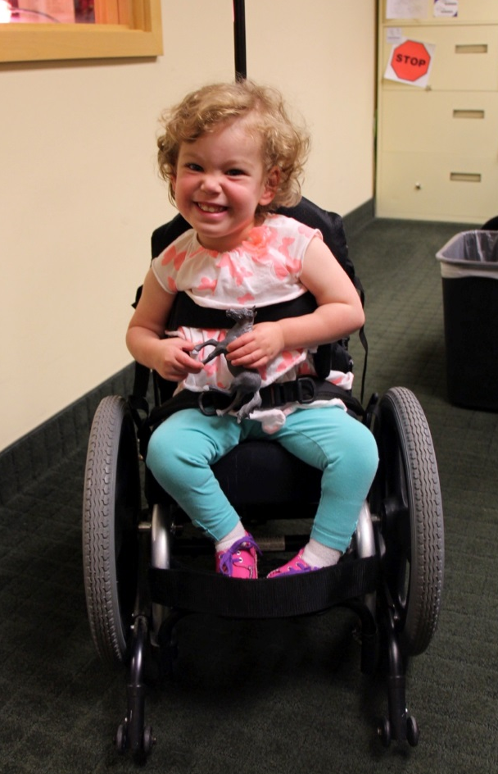
Closing Thoughts
When a child starts using AT at an early age, the technology can be life-changing!
Notes:
Slide 51: Closing Thoughts
Presenter Notes:
As people involved in the lives of young children with special needs, we have a unique opportunity to make life-changing differences. A thoughtful AT consideration process provides the opportunity to look closely at needs and pair them with technology that may allow young children to more independently and confidently interact with their environment. Everything from simple, do-it-yourself AT to complex, high-end devices can have a major impact on the life of a young child. By taking the time to have a Child-Centered AT conversation as an IFSP or IEP team, it may forever impact the life of a child.

Slide 52
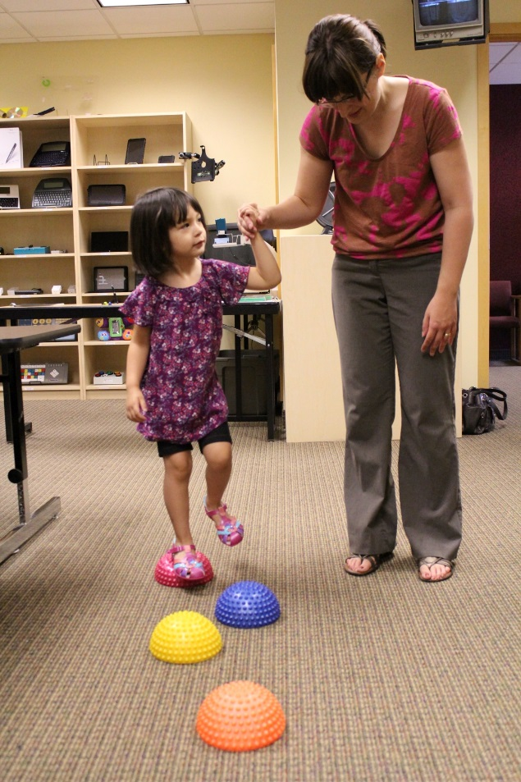
Closing Thoughts
If there is no need for assistive technology, it is best practice to write this in the IFSP or IEP.
Notes:
Slide 52: Closing Thoughts
Presenter Notes:
If there is no need for assistive technology, it is best practice to write this in the IFSP or IEP. Including the statement, “AT was considered and is not needed,” is very important. It clearly communicates that AT was considered and protects both families and professionals. It ensures that everyone is on the same page and provides a common document that can be referenced if there are questions later about whether or not AT was considered.

Slide 53
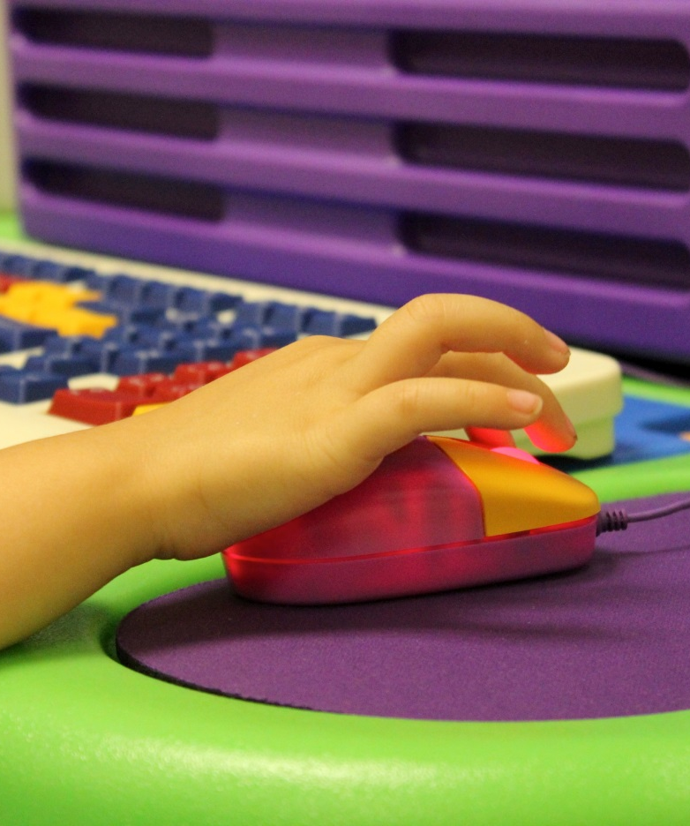
Closing Thoughts
If the child’s needs, environments, or situations change, you can call another meeting to revisit the need for AT and revise.
Notes:
Slide 53: Closing Thoughts
Presenter Notes:
If the child’s needs, environments, or situations change, you can revisit the need for assistive technology. You are not stuck with the existing IFSP or IEP. If changes need to be made, any team member can call a meeting to revisit and revise the document. Remember, in general, the consideration of assistive technology is a short discussion matching needs with technology.

Slide 54
Questions?
Notes:
Slide 54: Questions?
Presenter Notes:
Thank you for letting us share this very important information with you. Please take a minute to complete the TIKES workshop evaluation. We appreciate your feedback and comments very much.

Slide 55
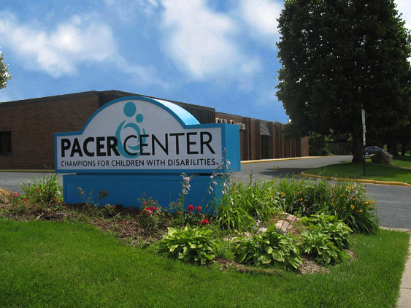
Contact Information
Technology to Improve Kids’ Educational Success (TIKES)
PACER.org/stc/tikes
952-838-9000
Funded by the U.S. Department of Education, Office of Special Education Programs (OSEP)
TIKES is a project of
PACER Center
PACER.org | 952-838-9000 | 888-248-0822
Notes:
Slide 55: Contact Information
Presenter Notes:
For information about this or other training materials available through the TIKES project, please contact them using the above contact information.

Slide 56
Funding Statement
The contents of this publication were developed under a grant from the U.S. Department of Education, # H327L120005. However, the content does not necessarily represent the policy of the U.S. Department of Education, and you should not assume endorsement by the Federal Government.
While permission to reprint this publication is not necessary, the citation should be: Simon Technology Center (2015). Technology to Improve Kids’ Educational Success (TIKES), Minneapolis, MN, PACER Center.
Alternate formats available upon request.
Notes:
Slide 56 : Funding Statement
Presenter Notes:
The contents of this publication were developed under a grant from the U.S. Department of Education, # H327L120005. However, the content does not necessarily represent the policy of the U.S. Department of Education, and you should not assume endorsement by the Federal Government.
While permission to reprint this publication is not necessary, the citation should be: Simon Technology Center (2015). Technology to Improve Kids’ Educational Success (TIKES), Minneapolis, MN, PACER Center.
Alternate formats available upon request.

