Slide 1
Kids Take On Bullying
Webinar Series
Session 5

Slide 2
What will the webinar series include?
Reminders:
We just have one session left!
Last session – Thursday, March 31st at 2:30 pm CST
We will stay on for the last 15 minutes after the session to answer any questions!
Each session will be recorded & available to watch if you aren’t able to make a session. These will be posted on KidsTakeOnBullying.org the following day.

Slide 3
What Does Inclusion Mean?
Let’s talk about what it means to include!
What does inclusion mean?

Slide 4
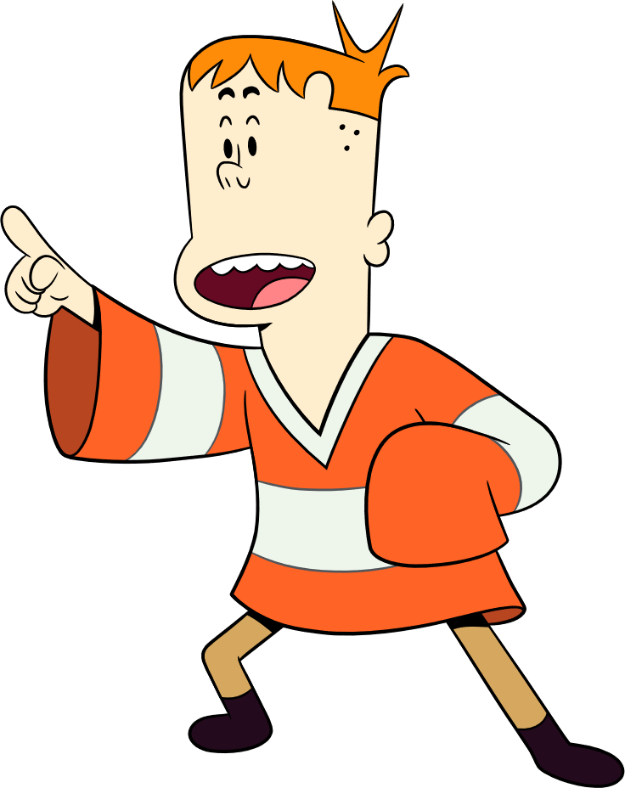
What Does Inclusion Mean?
Inclusion
Inviting and involving others so that everyone feels welcomed, valued and supported.

Slide 5
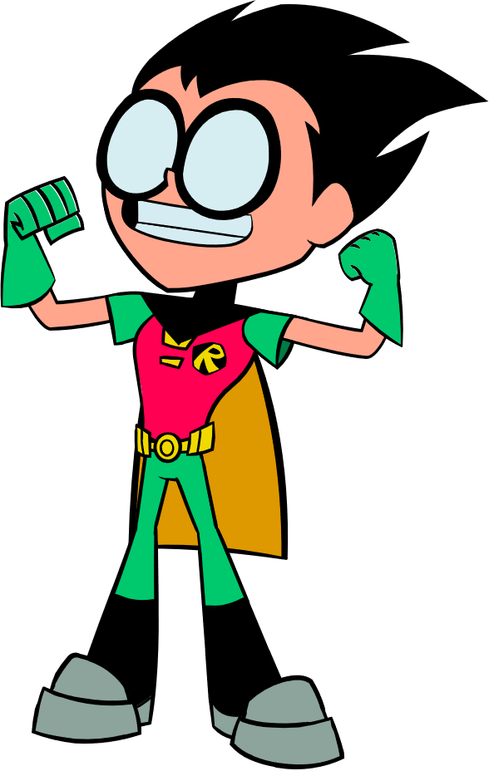
What Does Inclusion Mean?
To INCLUDE someone is to bring them IN so that they feel like they are a part of something. It could be as simple as a conversation, engaging in an activity together, or asking them to participate in a group.
When someone is included, it helps them feel respected, valued for who they are, and like they belong.

Slide 6
How Can We INCLUDE Others?
Introduce yourself to others
Notice when someone is alone & invite them to join you
Invite others to play
Tell someone why they are inspiring
Show interest in learning about experiences different than yours.

Slide 7
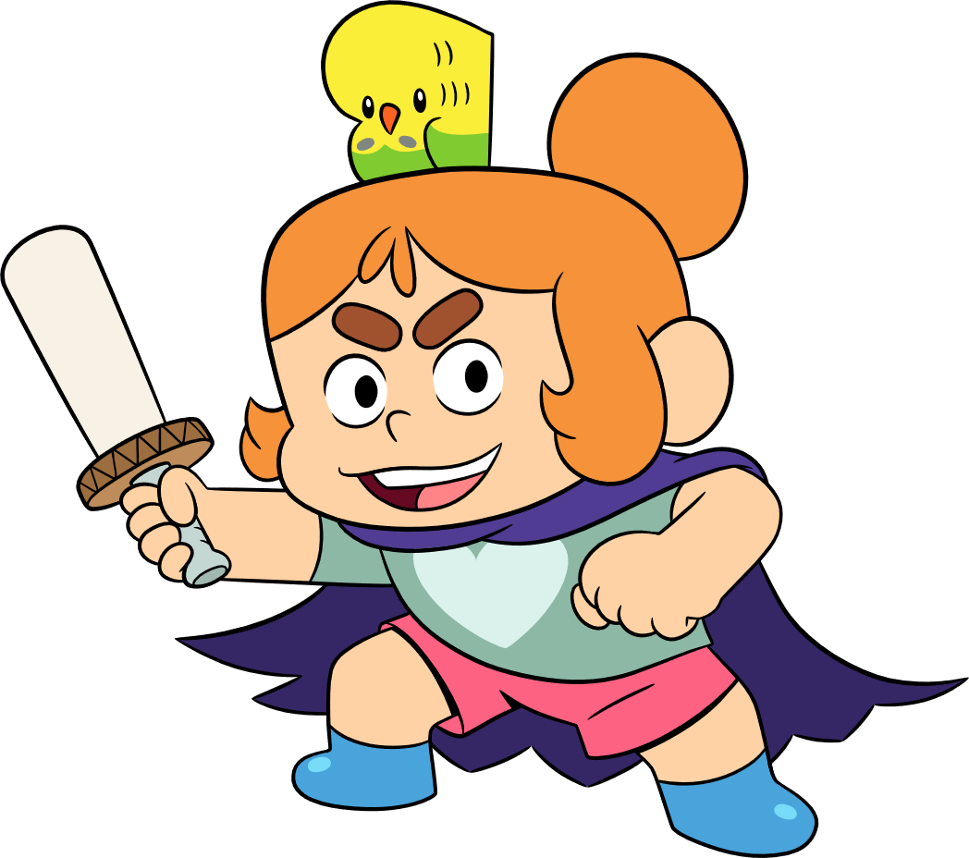
What Else Can You Do If You See Bullying?
Speak up!
When students are willing to say they think something is wrong, they can make a difference. Your words matter, try saying:
I’m here for you & I want to help.
You didn’t deserve to be treated that way.
Can I help you find an adult to talk to?
If you see bullying, tell an adult. Remember, it’s NOT tattling or snitching, it’s okay to tell.

Slide 8
What’s Your Advice?
On PACER’s Kids Against Bullying Website, we have an advice column called Ask Carmen! Students from across the country send Carmen questions and ask her advice.
We have a few questions from kids that wanted YOUR advice! Read their question and think about the following:
“What advice would you give?"

Slide 9
What’s Your Advice?
Our friends are bullying some people. We want to stop it, but we don’t want them to get mad at us and then bully us!
– Libby, 5th grader

Slide 10
What’s Your Advice?
A so called friend has been bullying me and my friends a lot through cyberbullying us through text. It makes us break down and cry. Yesterday she told me that I need to grow up and let it go about the harsh words she said about my brother. I need help. Help me!
– Morgan, 6th grade

Slide 11
What’s Your Advice?
Yesterday on the playground, a guy told me I couldn’t play kickball with him and the other guys. Then he threw the ball at me. He laughed when it hit my head. It really hurt. I told him to stop. He just laughed and ran away. I want to tell my teacher, but I’m afraid the other guys will think I’m a tattletale. Do I just have to deal with it on my own?
– Devon, 3rd grade

Slide 12
What’s Your Advice?
There is a lot of bullying at my school and around my town. I am doing a project about how not to bully but want to know if you have any other ideas on how I can help?
– Jake, 4th grade

Slide 13
Explore The Impact!
In this week’s activity, we’ll be exploring the impact of some of the ideas we talked about last week. For each idea, think about:
How will it help other students at your school?
Who would need to help?
How much do you think it cost?
How long would it take to develop?
Could it continue from year to year?

Slide 14
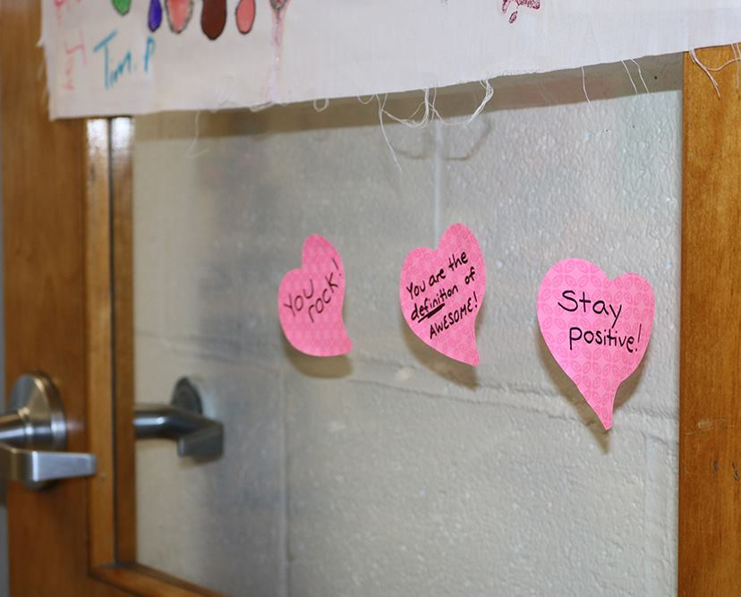
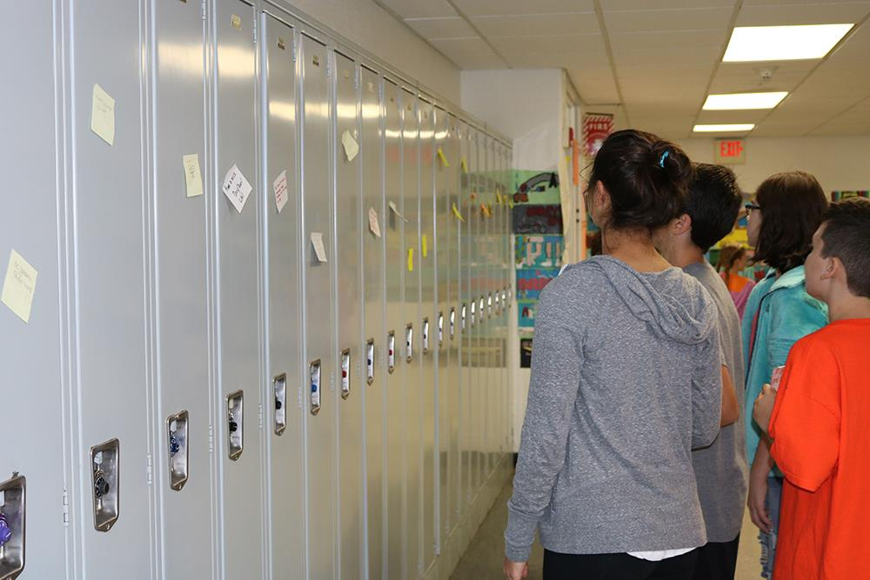
School Kindness Notes

Slide 15
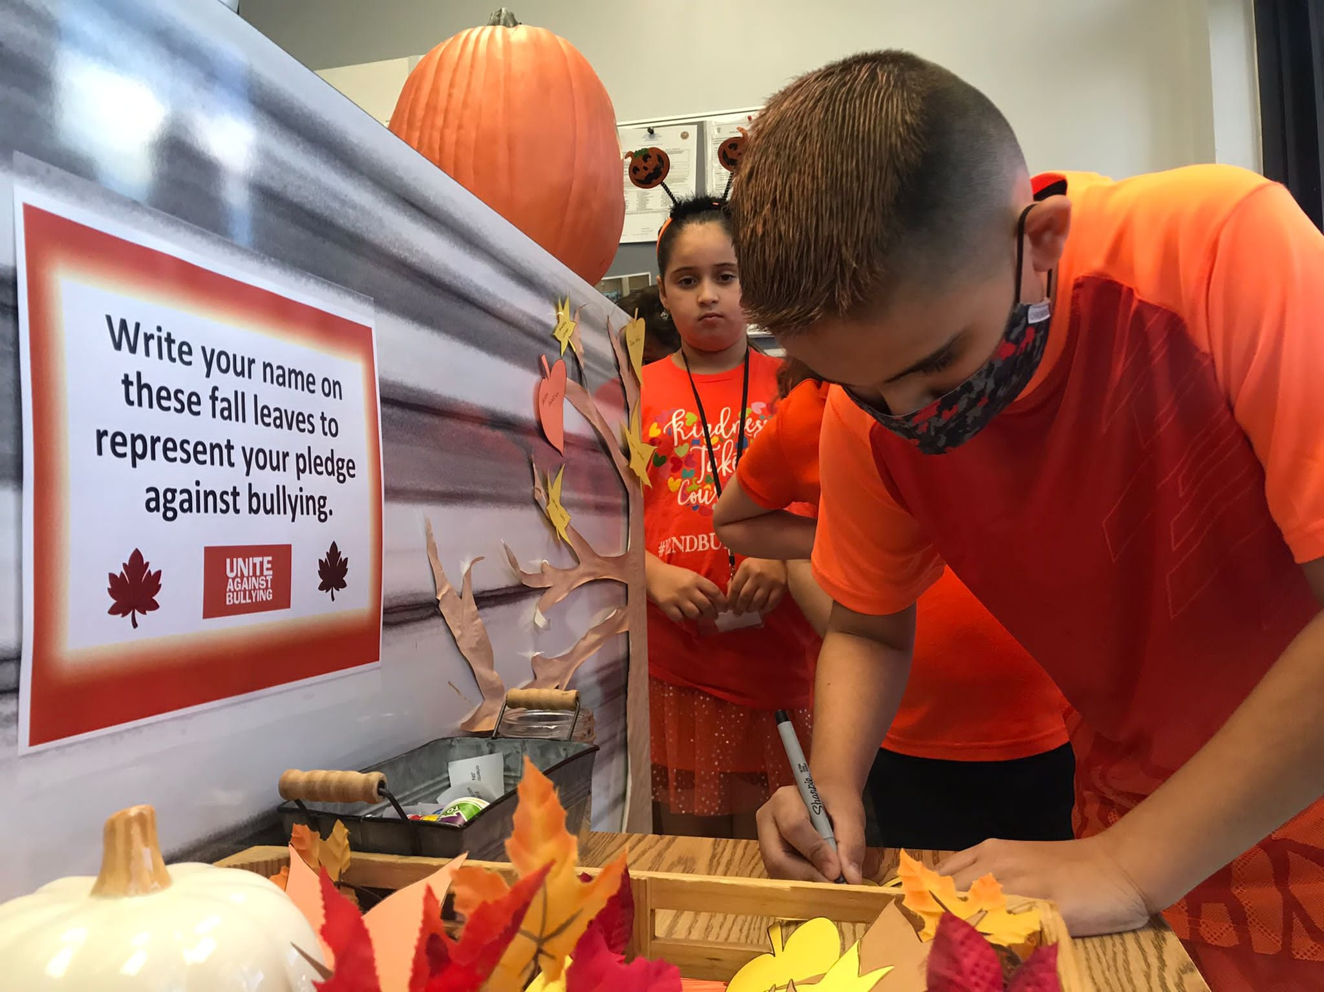
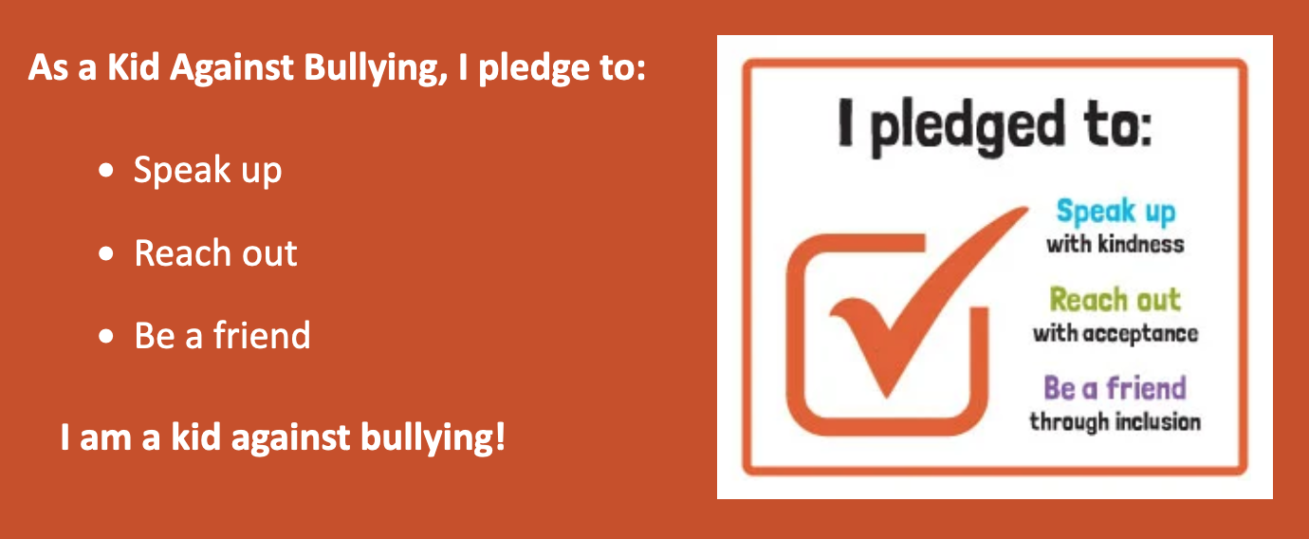
Pledge Signing

Slide 16
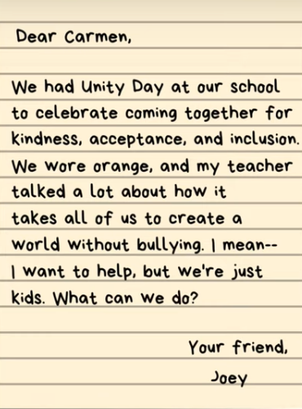
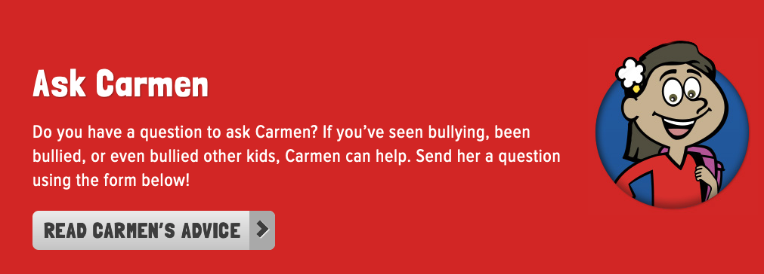
Student Advice Column

Slide 17
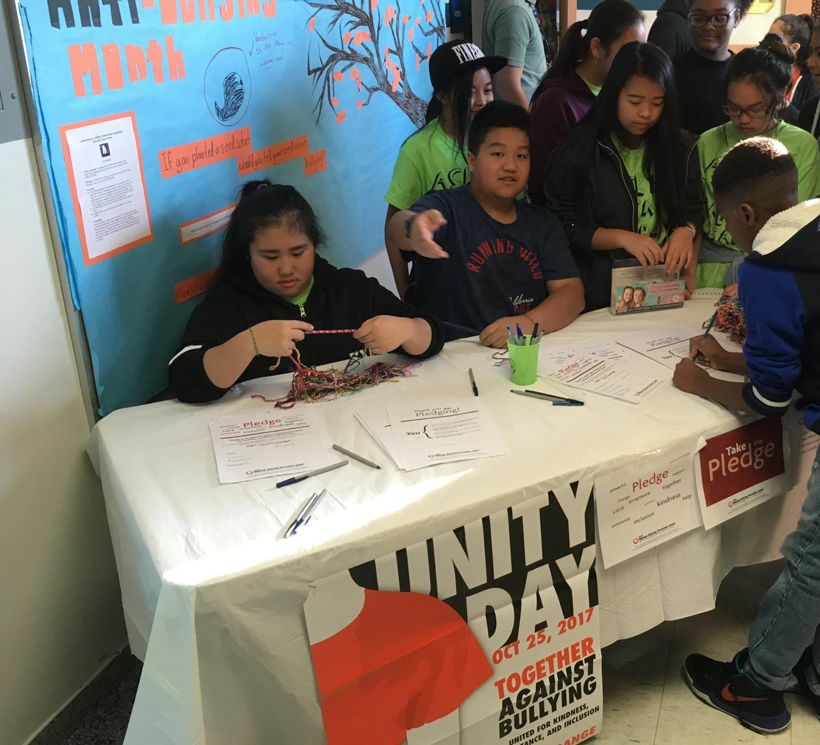
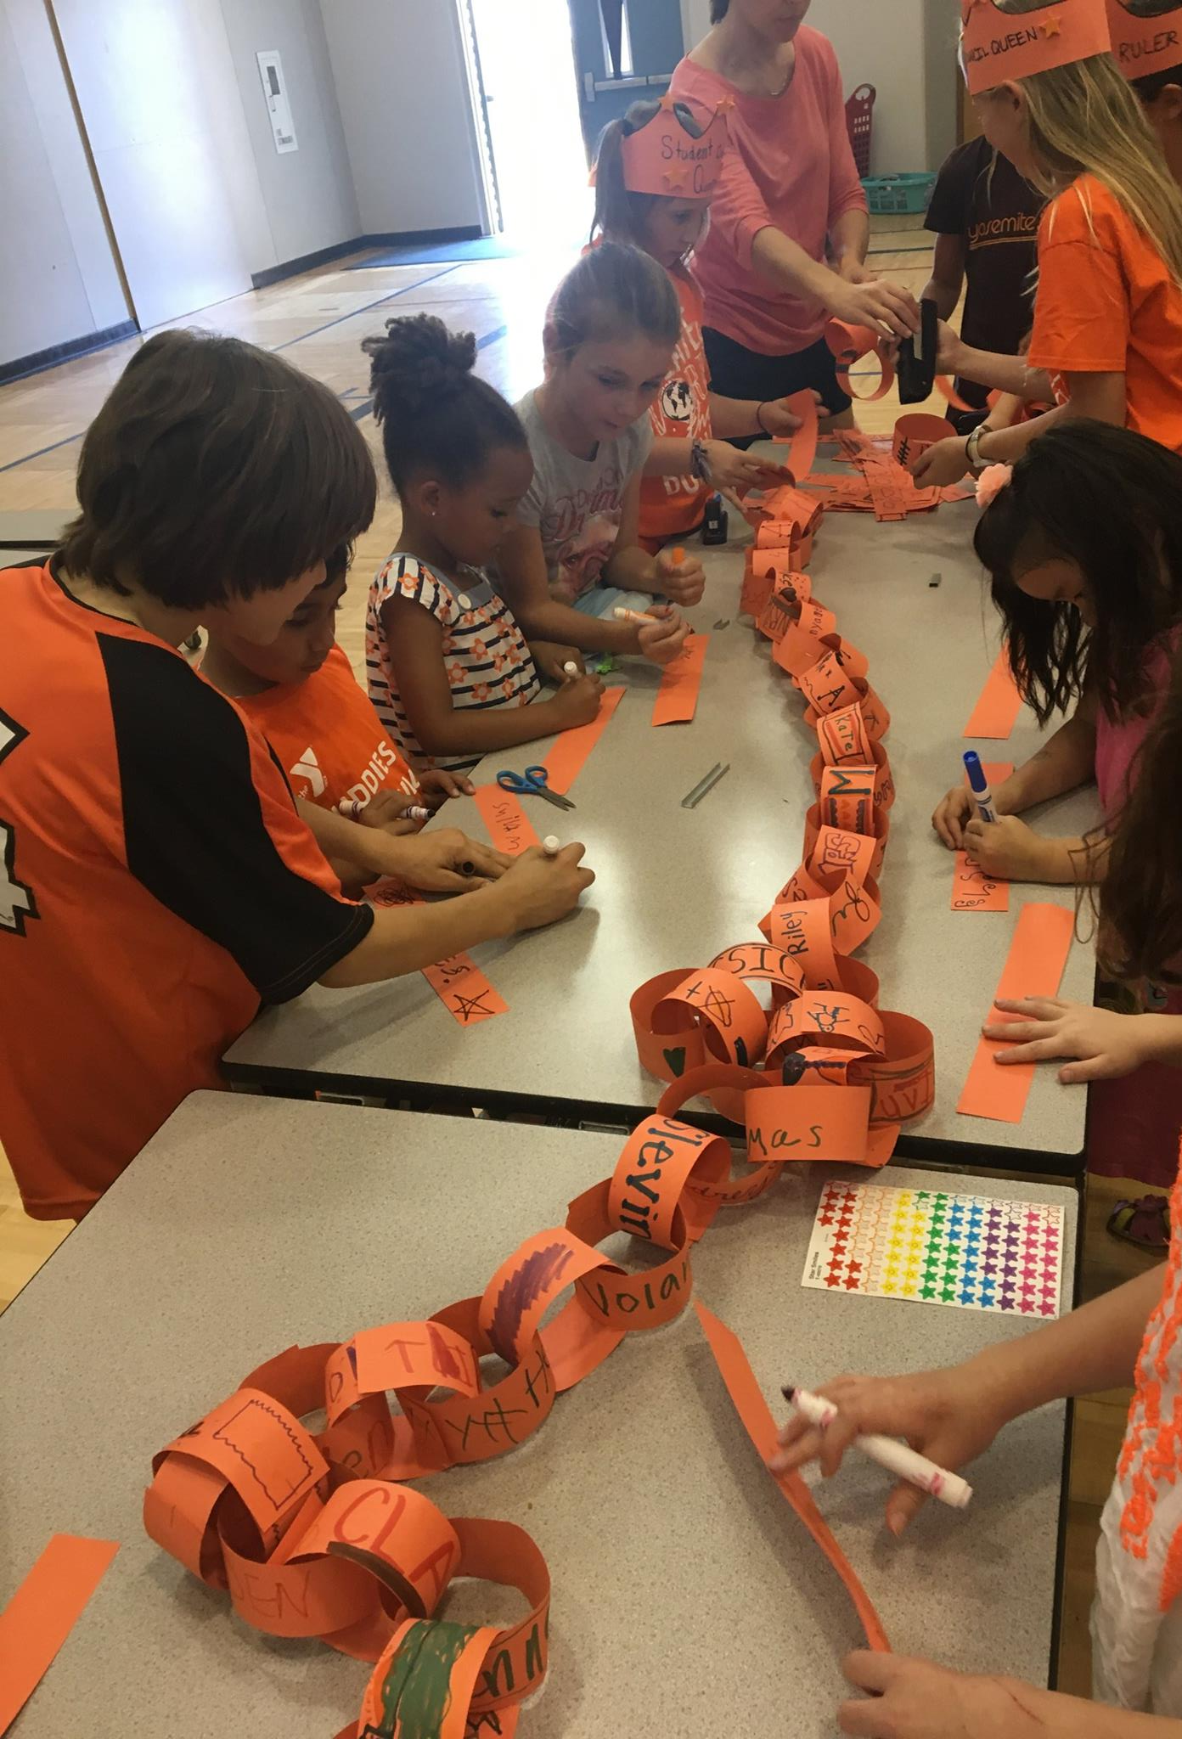
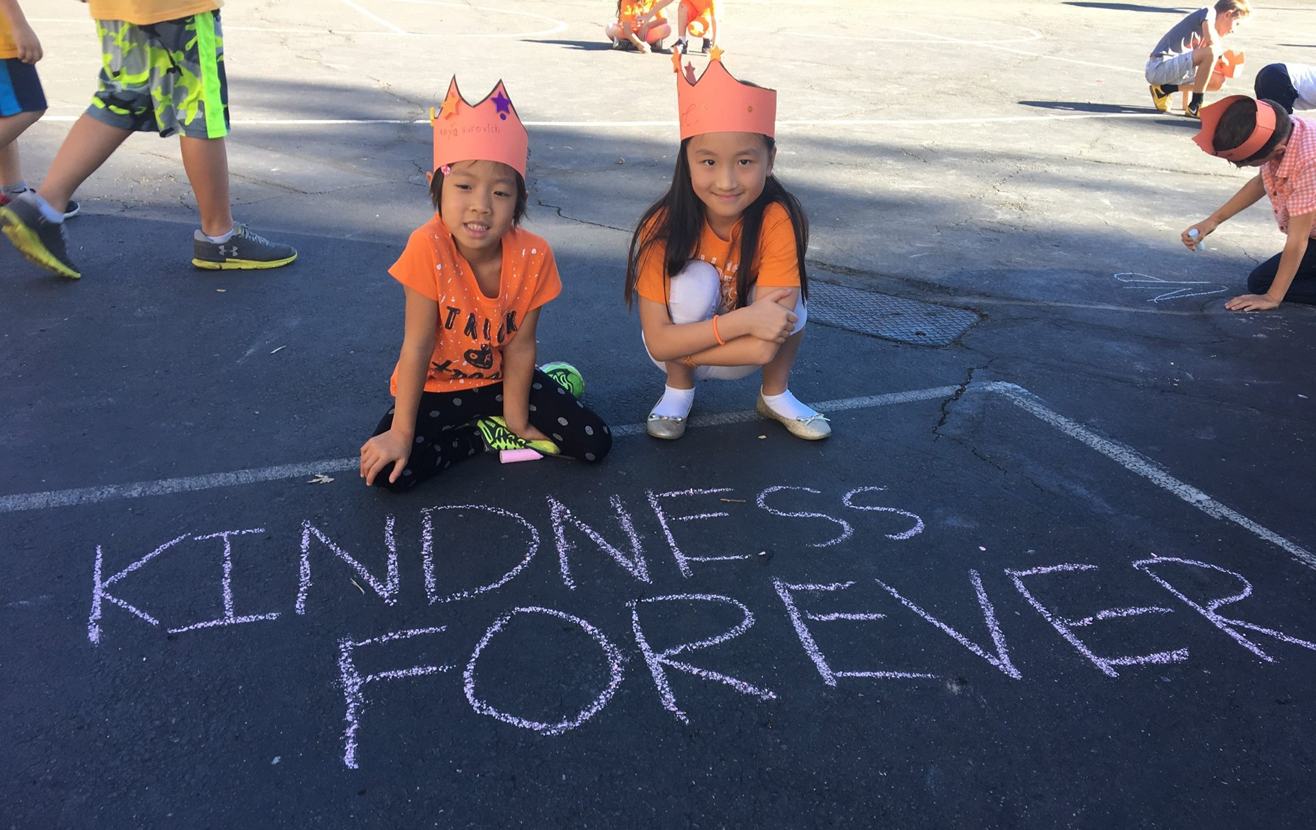
School Kindness Club

Slide 18
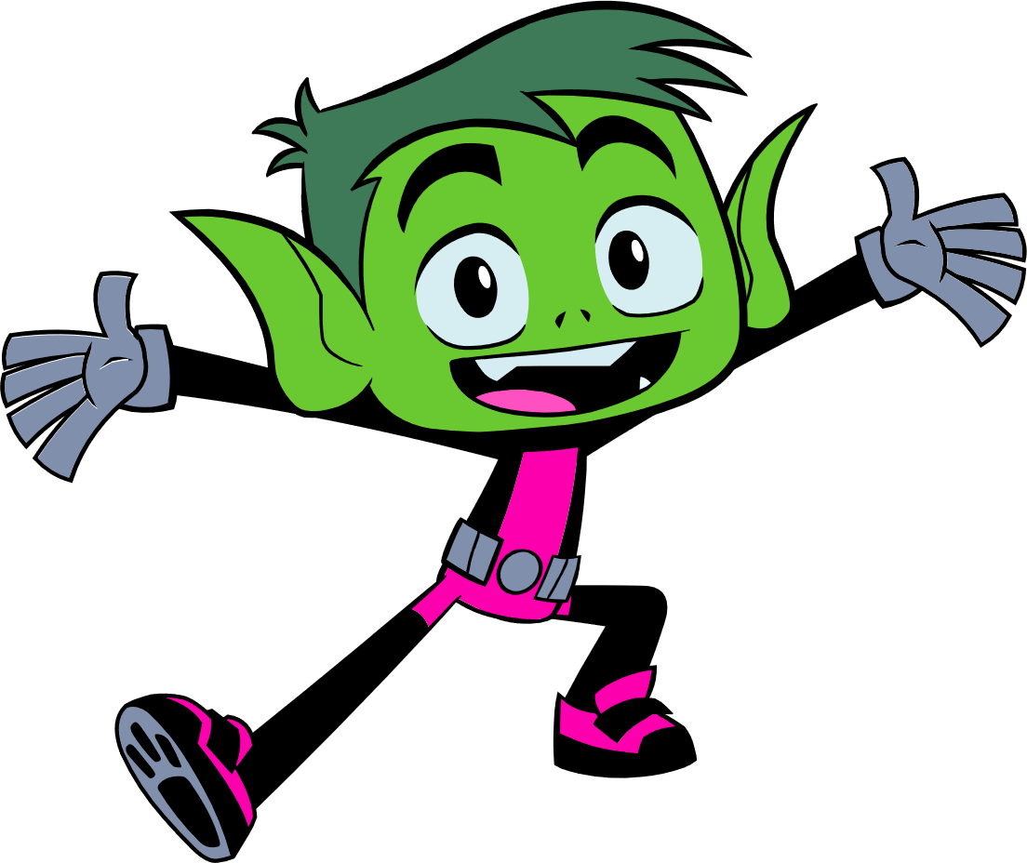
Reflection Questions
Why is it important for students to get involved in bullying prevention?

Slide 19
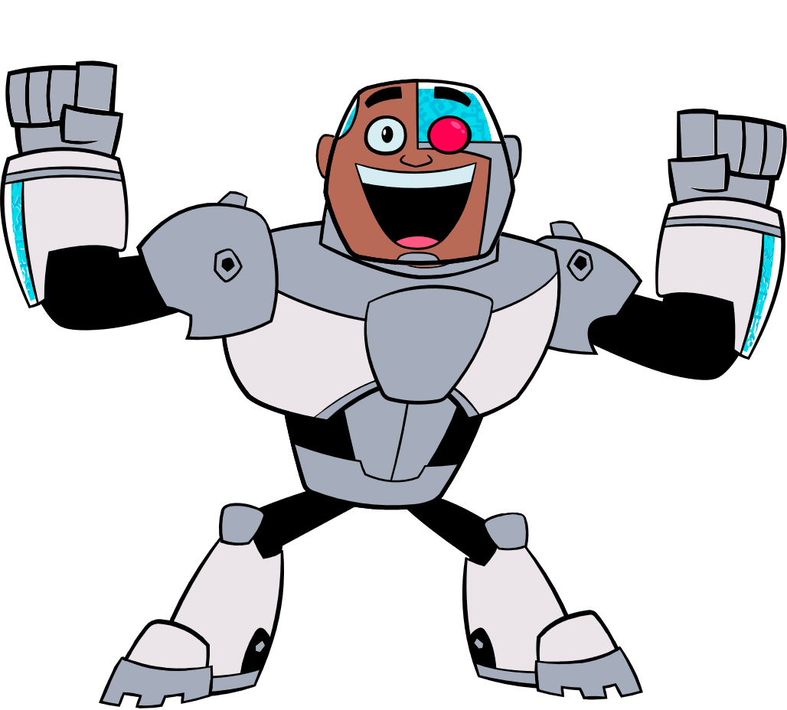
What To Expect Next Week
LAST SESSION: Thursday, March 31st at 2:30 pm CST
REMINDERS:
This webinar will be archived and posted at KidsTakeOnBullying.org + the PowerPoints!
We will be available for the next 15 – 20 minutes if you have any questions!

